Slide 1
RDKit for Deep Learning and Chemical Kinetics Chemprop, RMG, and RDMC
Nathan Morgan, Jackson Burns and Xiaorui Dong
RDKit UGM
April 10, 2025

Slide 2
Chemprop

Slide 3
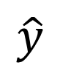
Chemprop fits a model to chemical data
CCC(C)N1CCCC1
SMILES
$$\hat{y}$$
Prediction

Slide 4
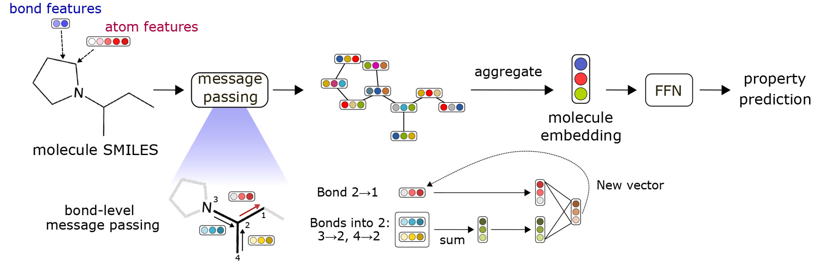
Chemprop information flow
Feats.
Feats.
Nodes
Edges
CCC(C)N1CCCC1
SMILES
Connectivity
“MolGraph”
$$\hat{y}$$
Learned Graph Embedding
Message Passing
Learned Node Embed.
Aggregation
FFNN
Prediction

Slide 5

Chemprop uses RDKit to make MolGraph
Feats.
Feats.
Atomic num., #H’s, Aromatic?, Etc.
Nodes
Edges
CCC(C)N1CCCC1
SMILES
Connectivity
“MolGraph”
Bond type, In ring?, Etc.
$$\hat{y}$$
Learned Graph Embedding
Message Passing
Learned Node Embed.
Aggregation
FFNN
Prediction

Slide 6
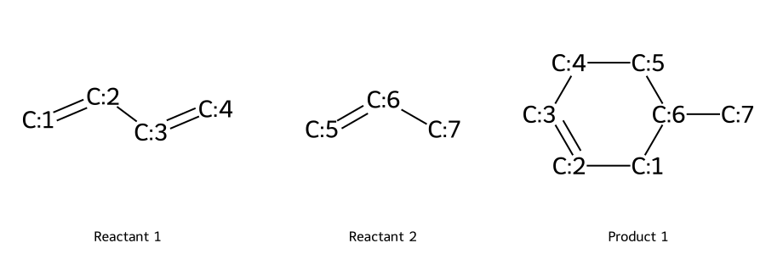
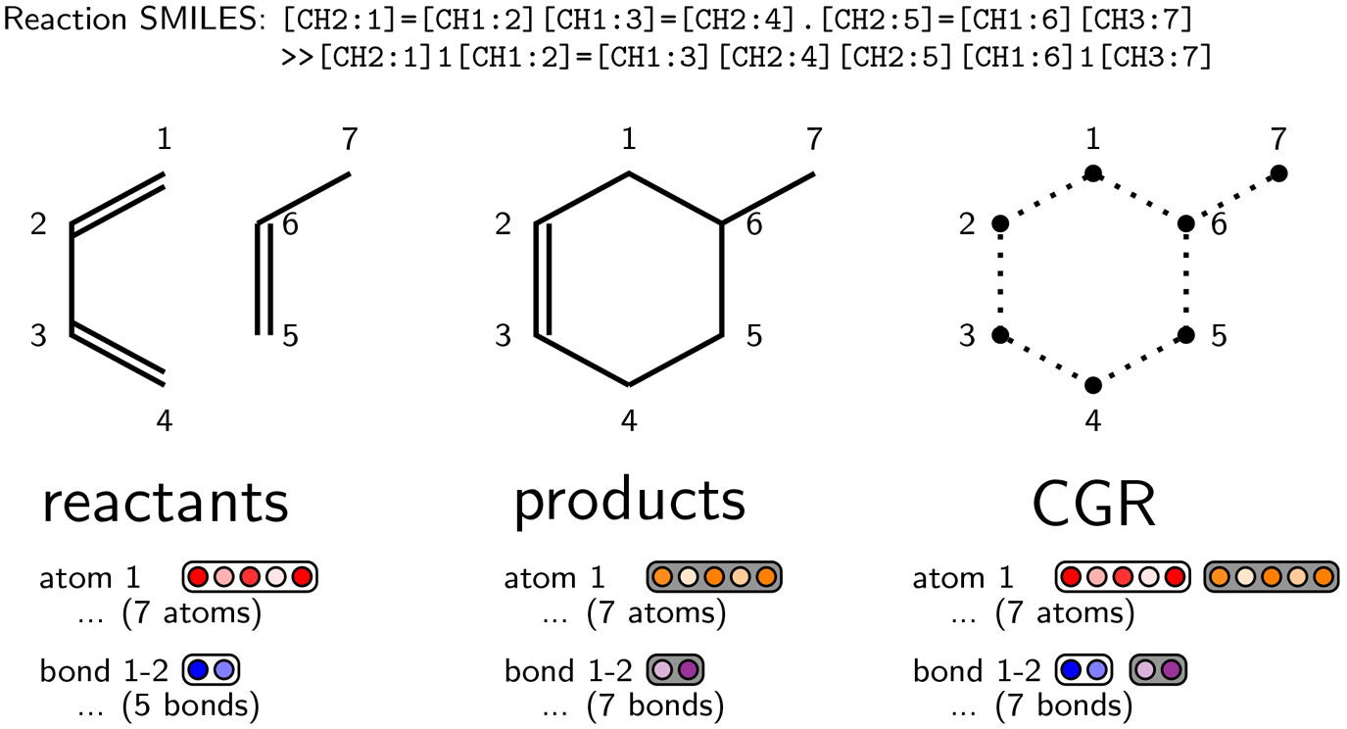
Reaction graph from RDKit
Featurize all atoms and bonds
Concatenate reactant and product features
Feats.
Feats.
Nodes
Edges
Connectivity
CGR: Condensed Graph of Reaction
“MolGraph”
Heid, E.; Greenman, K. P.; Chung, Y.; Li, S.-C.; Graff, D. E.; Vermeire, F. H.; Wu, H.; Green, W. H.; McGill, C. J. Chemprop: A Machine Learning Package for Chemical Property Prediction. J. Chem. Inf. Model. 2024, 64 (1), 9–17. https://doi.org/10.1021/acs.jcim.3c01250.

Slide 7
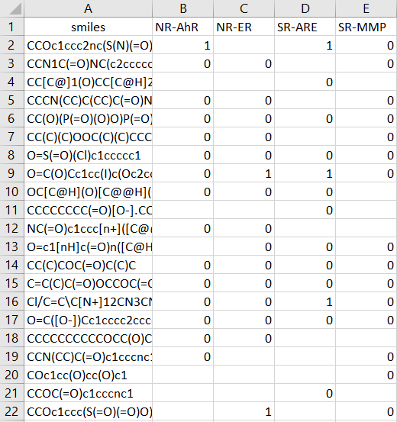
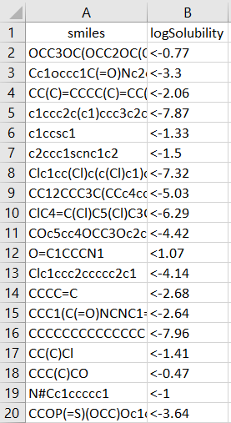
Chemprop via command-line interface
Hyperparameter optimization
Regression
Bounded Regression
Classification
Multi-class Classification
Multi-task
Uncertainty Quantification
MVE
Evidential
Quantile
Ensembling
Transfer Learning

Slide 8
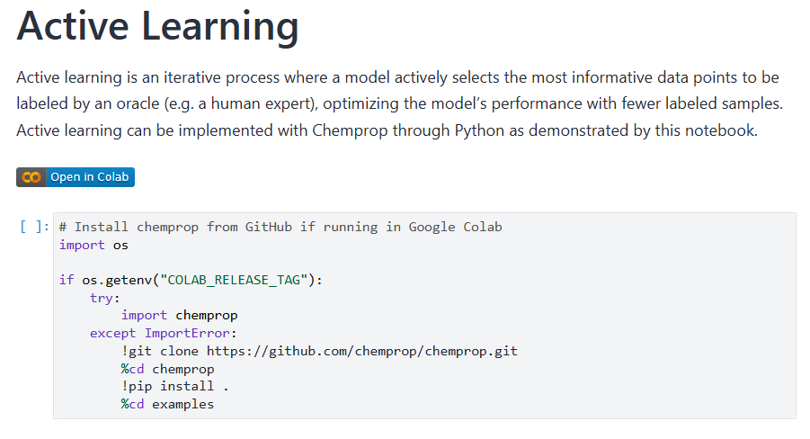
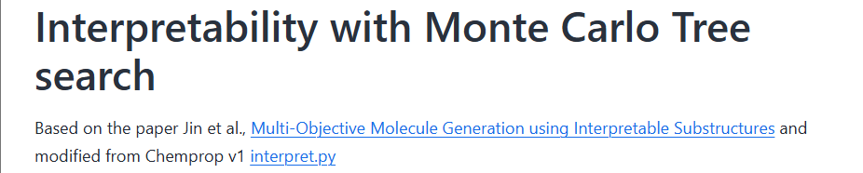
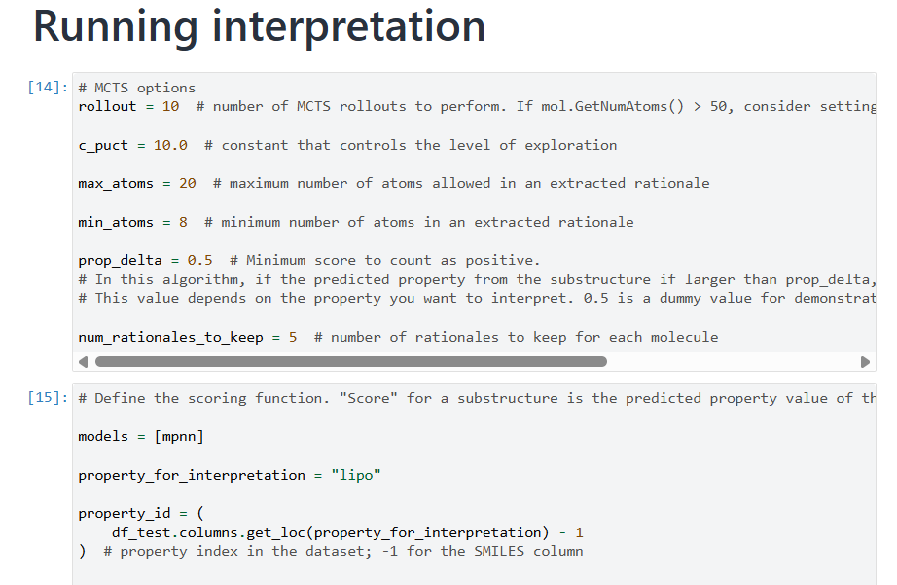
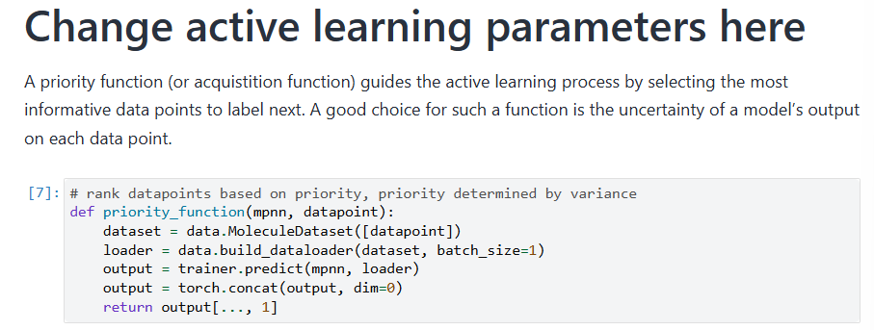
Chemprop via Python scripts

Slide 9
Summary
If you have SMILES + Property data
pip install chemprop and try training a chemprop model
Use the CLI for low to no coding
Follow our example jupyter notebooks for customized workflows
If you have questions/comments
Open an issue on the chemprop GitHub
https://github.com/chemprop/chemprop
https://chemprop.readthedocs.io/en/latest/index.html

Slide 10
RMG

Slide 11
Purpose of RMG
RMG aims to predict the reactive chemistry of a given system by automatically determining the relevant species and reactions under the specified conditions, and providing all the numbers needed inside a simulation.
+ Reduce the human effort needed to construct a useful kinetic model, so make it more practical to build good models.
+ Current version of RMG is particularly useful for pyrolysis & combustion, but it can also be applied to other systems (e.g. gas-surface catalysis, liquid phase).

Slide 12
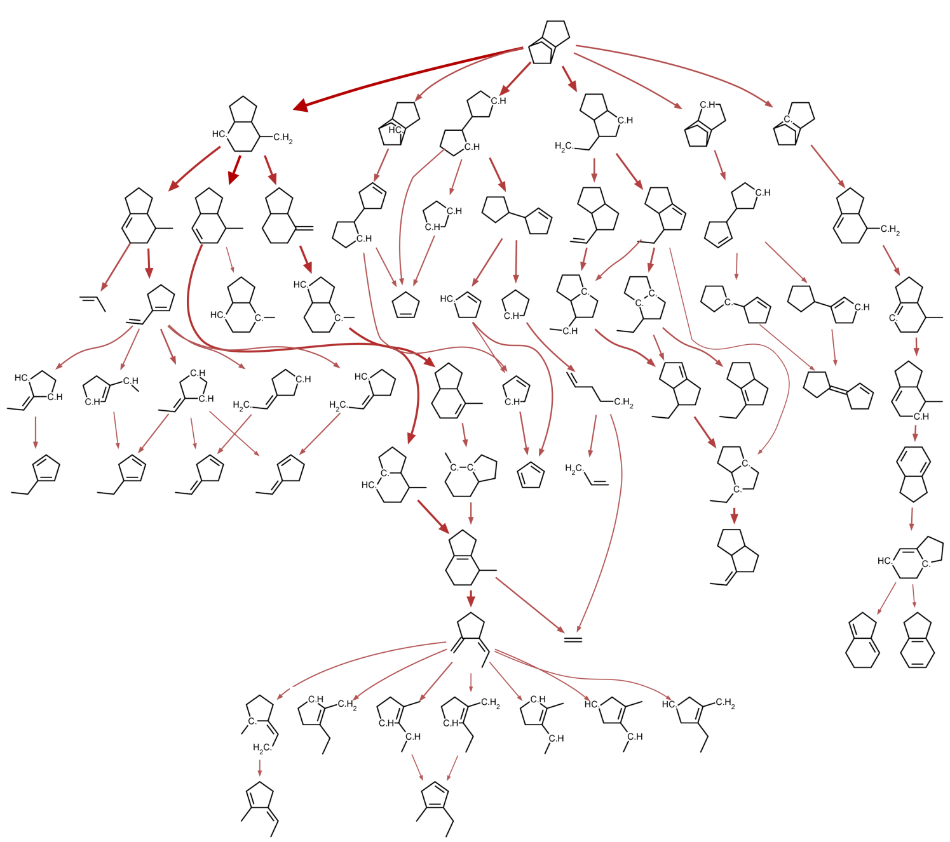
Reaction Mechanism Generator
A predictive tool for reacting chemical systems
RMG constructs comprehensive models consisting of elementary reactions
& estimates unknown kinetics and thermo
Large open source package under active development, includes many tools for building/solving/analyzing kinetic models for broad range of systems.
Databases & methods for estimating all the parameters in the models.
C.W. Gao et al. Comput. Phys. Commun. 2016 203, 212–225
M.J. Liu et al. J. Chem. Inf. Model. 2021 61, 2686-2696
M.S. Johnson et al., J. Chem. Inf. Model. 2022 62, 4906-4915.

Slide 13
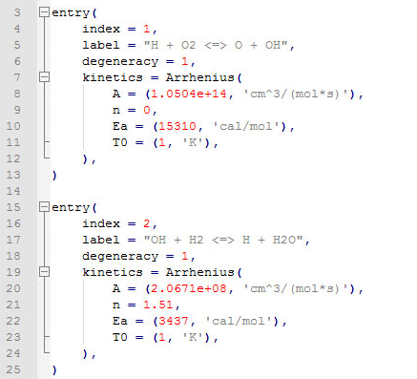



Motivating RMG Example
Inlet conditions and composition (T, P, X)
Kinetic and thermodynamic libraries
Kinetic model
Tolerances
Termination criteria
(time, conversion)
RMS

Slide 14
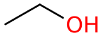
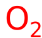

Reaction Mechanism Generator incrementally grows mechanisms
Example: ethanol oxidation
1000 ppm fuel, stoichiometric O₂, in Ar
at 1500 K, 1 bar
Core
Edge

Slide 15
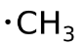
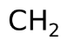

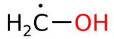
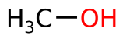
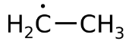
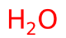
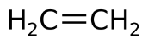

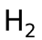
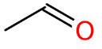
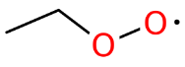
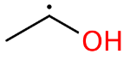
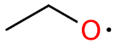
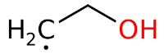
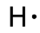
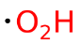
Reaction Mechanism Generator incrementally grows mechanism
Example: ethanol oxidation
1000 ppm fuel, stoichiometric O₂, in Ar
at 1500 K, 1 bar
+
unknown kinetics / thermodynamics
data are estimated

Slide 16
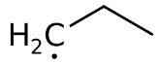
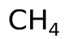
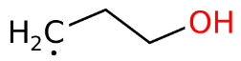
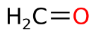

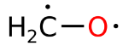
Reaction Mechanism Generator incrementally grows mechanism
Example: ethanol oxidation
1000 ppm fuel, stoichiometric O₂, in Ar
at 1500 K, 1 bar
+

Slide 17

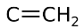
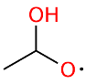
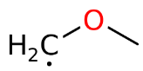
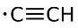


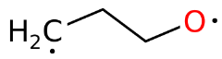

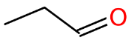
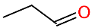
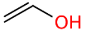
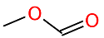

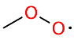
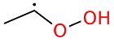
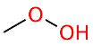
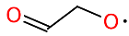
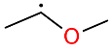
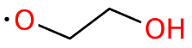
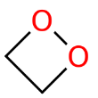




























Reaction Mechanism Generator
Example: ethanol oxidation
1000 ppm fuel, stoichiometric O₂, in Ar
at 1500 K, 1 bar

Slide 18
At termination: core contains our mechanism; edge species classified as negligible
Example: ethanol oxidation
1000 ppm fuel, stoichiometric O₂, in Ar
at 1500 K, 1 bar
Core:
42 species, 592 reactions
Core + Edge: 775 species, 1604 reactions
(tolerance = 1%; termination rate ratio = 0.1%; execution time = 30 min)

Slide 19

RMG and RDKit
RDKit SMILES input and output are core to RMG functionality
RMG has some resonance structure generation unique to Molecule class
RMG is currently being updated to take advantage of more of RDKit
Upgrading to modern Python, largely removing OpenBabel
Removing our workarounds for patched RDKit bugs
@pytest.mark.skip(reason='This unit test checks for a bug which has been patched in version of RDKit >= 2022.9.1.')
def test_failure_message(self, mock_logging):
mol = Molecule(smiles="[CH2-][N+]#N")
with pytest.raises(ValueError, match="Unable to generate identifier type"):
to_inchi(mol, backend="rdkit")

Slide 20
RDMC

Slide 21





RDMC
An open-source software package leveraging RDKit functionalities, offering user-friendly cheminformatics tools for
Chemical kinetics: elementary reaction, transition states, …
Highly reactive species: free radicals, …
Physics-based models
Computation
Reaction
etc.
Data
Machine Learning models

Slide 22
Motivation and Pain Points at Green Group
Functionality
Preserve atom mapping throughout transformations
Deal with free radical species
3D structure generation, modification, visualization
Expose RMG functionalities to the broader community
Development
Light-weight and adaptable architecture
Low maintenance
Avoid reinventing wheels

Slide 23
RDKit picked as key building block of RDMC
RDKit was a natural choice
Broad coverage of widely needed functionalities
Efficient, adaptable, and actively maintained
Widely adopted with strong community support
However
Our use case diverges from RDKit’s primary design scope
Led to a steep learning curve*
The need for custom workarounds
* Fortunately, growing resources—such as the RDKit and Pat Walters’s blogs, and LLMs—have significantly eased the process

Slide 24
Inside RDMC: two modules
rdtools
rdmc

Slide 25
rdtools module
rdtools
mol
atommap
RDKit Objects
Atom
Bond
Mol
Reaction
bond
compare
conf
conversion
Properties
Modified objects
…
dist
element
featurizer
fix
view
resonance
…
RDKit NumPy SciPy
py3Dmol
openbabel
Directly applicable on RDKit objects

Slide 26


Example Functions in rdtools: Conversion
SMILES ⇨ Mol
( )
[O:1]([C:3]([C:2]([H:4])([H:5])[H:6])([H:7])[H:8])[H:9]
mol_from_smiles
RDKit: FIFO
Incorrect Graph
XYZ ⇨ Mol
Molecule XYZ
Correct Graph
mol_from_xyz
fix_mol

Slide 27



Example Functions in rdtools: Resonance
Free Radical Resonance Structures
rdtools .resonance
re-implement the RMG algorithm (Dana et al. approach)
change of APIs
using SciPy for MILP
performance optimization
Important for
cleaning radical data
Reaction template analysis and extraction
…
Generate_resonance_structure

Slide 28






Example Functions in rdtools: 3D viewers
Call py3Dmol viewer more easily by passing RDKit Mol objects
mol_viewer
freq_viewer
reaction_viewer
mol_animation
conformer_viewer
ts_viewer

Slide 29
rdmc module
Building more complicated tools by combining
different rdtools
rdtools with other deps
into classes
rdmc
mol
reaction
rxntp
networkX
logparser
cclib
Conformer_generation
various
rdtools
…

Slide 30

Example Usage of rdmc: reaction
Provides more robust reaction comparisons for elementary reactions and radical reactions

Slide 31


Example Usage of rdmc: rxntp
Utilize a truncated condensed graph of reaction representation facilitating reaction template extraction and analysis

Slide 32
Example Usage of rdmc: conformer_generation
Define Different tasks for the workflow of computing molecule and reaction properties using Quantum Chemistry:
Embedders, TS guessers, Optimizers, Verifiers, …

Slide 33

Workflow
Data
Preprocessing
Reactant and product structure
Generation
Transition States Guess Generation
QM Calculation

Slide 34
Workflow
Data
Preprocessing
Step 1. Define each tasks
Step 2. Define and run Generator
embedder
= TSEGNNGuesser(model_dir)
optimizer
= GaussianOptimizer(
method=level_of_theory,
nprocs=nprocs,
memory=memory
)
verifiers
= [
XTBFrequencyVerifier(),
GaussianIRCVerifier(
method=level_of_theory,
nprocs=nprocs,
memory=memory,
fc_kw="CalcFC,ReCalc=7"
)
]
…
generator =
TSConformerGenerator(
rxn_smiles=rxn_smiles,
embedder=embedder,
optimizer=optimizer,
pruner=pruner,
verifiers=verifiers,
sampler=sampler,
final_modules=final_modules,
save_dir=save_dir
)
generator(n_conformers=10)
Reactant and product structure
Generation
Transition States Guess Generation
QM Calculation

Slide 35





Codebase
Repository
Quality and Compatibility
https://github.com/xiaoruidong/rdmc
Installation
pip and conda
Python and Platform
Python >= 3.9
Windows / Ubuntu / MacOS
Linters, formatter, type checker
Ruff, mypy, pydoctlint, docformatter, pre-commit, …
Test
Pytest
coverage
CI
GitHub Actions
Docs
Sphinx
GitHub Pages
Developers
Dependencies
RDKit, NumPy, SciPy
Openbabel, NetworkX, matplotlib, cclib, py3Dmol, ASE, ipywidgets
Current and former Green Group members

Slide 36

Thank you!

Slide 38

4:00 – 4:15 break!

